Slide 1
How to advocate for yourself
Knowing when to speak up

Slide 2
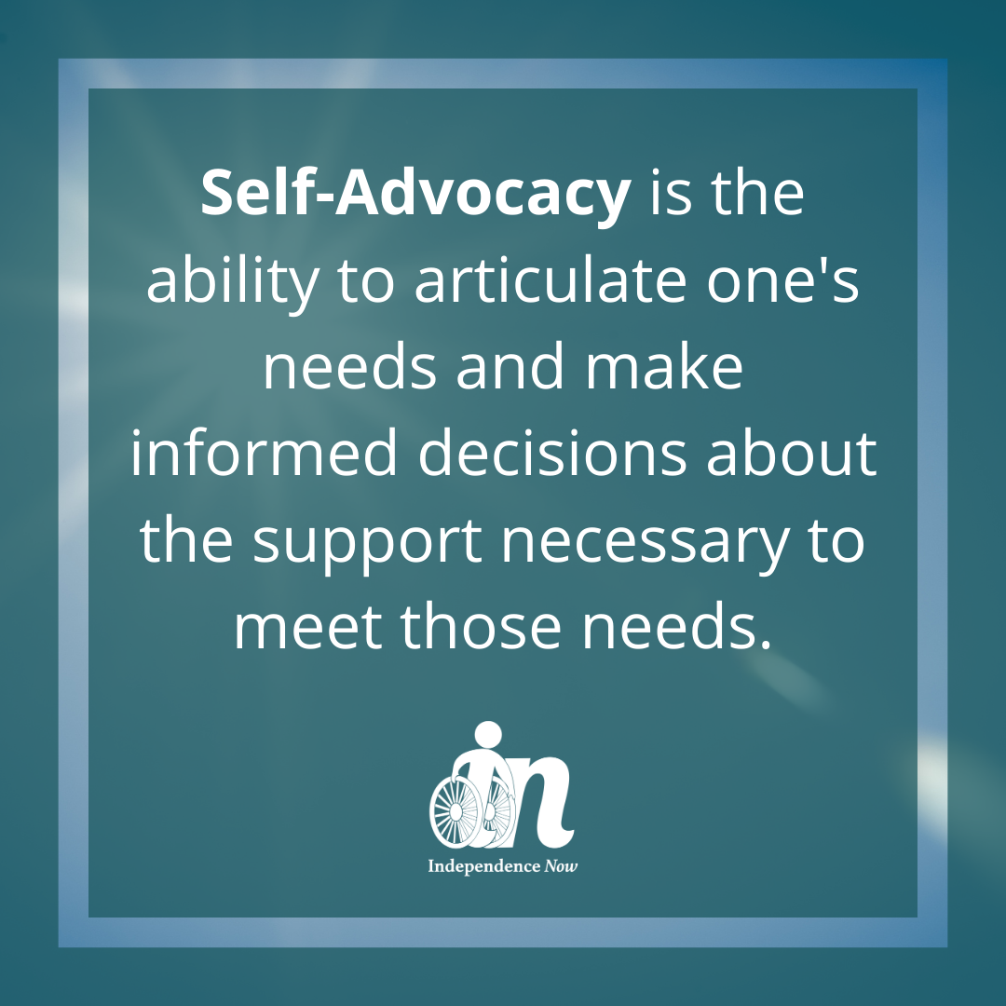
What does self-advocacy mean?
Self-advocacy means to speak up for yourself in a situation where you feel that your thoughts, emotions, or opinions have not been communicated for you properly. It is to ask for what you need and want to. You are able to make choices and decisions that affect your life and will take responsibility for those choices and decisions.

Slide 3
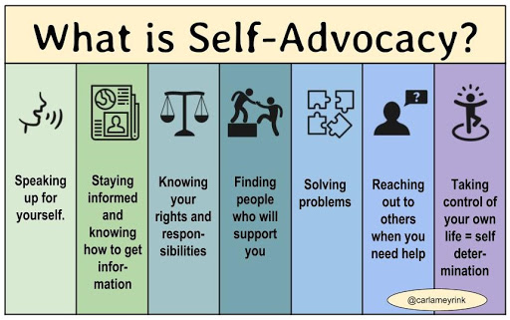
What you need to properly self-advocate
It is important to know your rights, have leadership skills, knowledge of self, and communication skills.

Slide 4

Reflection and discussion
Reflect and discuss a time when you didn’t advocate for yourself and how it turned out for you. Reflect and discuss a time where you did advocate for yourself and how it turned out.

Slide 5
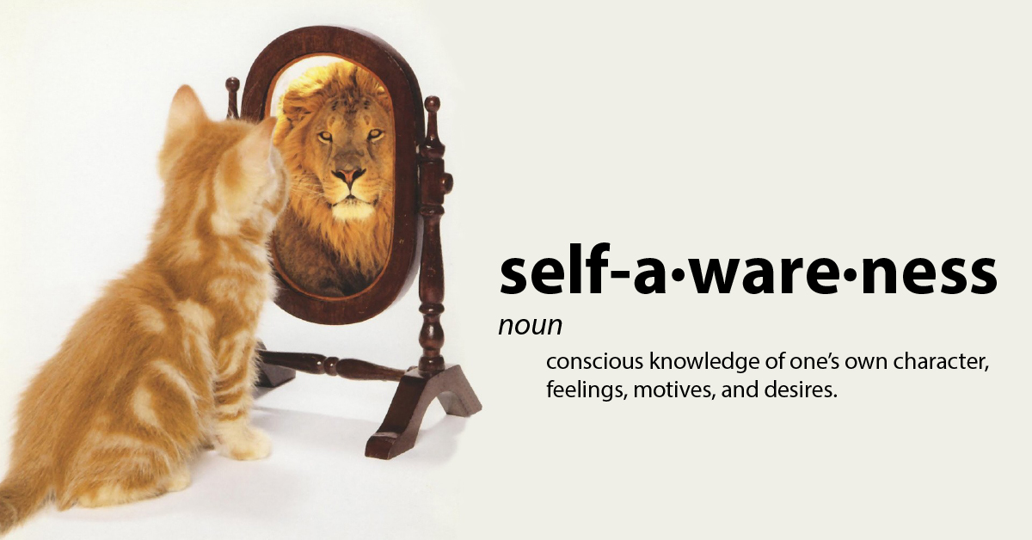
Why is it important?
Self-Advocacy is important because it allows you to take back your power and your sovereignty during your mental health journey. No one else knows your needs and wants better than you once you are self-aware and have come to an acceptance of your strengths and weaknesses.

Slide 6

Strengths and Weaknesses
Identify and write down a list of different types of strengths and weaknesses in mental health journey.

Slide 7
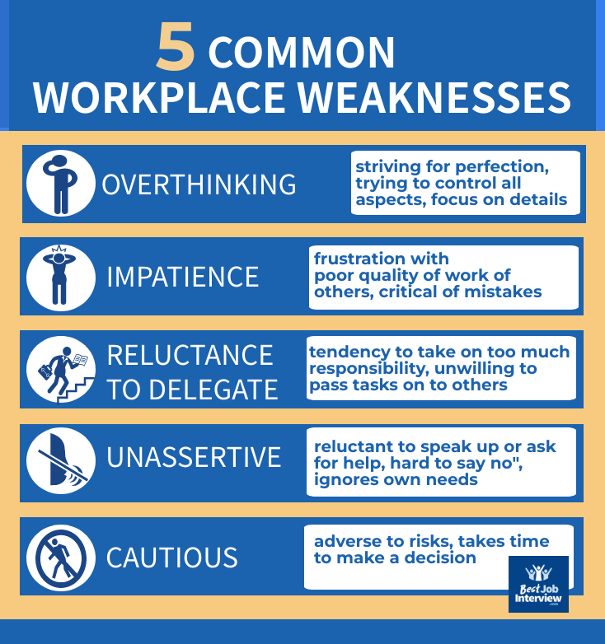
Create a personal list
Identify and list your personal strengths and weaknesses when it comes to mental health.

Slide 8

How to Advocate for yourself
Tell the person in advance you would like to speak to them when they are available (book time)
Speak calmly, clearly, and be thoughtful in your approach.
Focus on the most important topics and no more than 3-5 concerns.
Ask them open ended questions to gain better understanding.
Ask them how best to move forward.

Slide 9

Take back your power and fulfill your needs
Having a mental health issue does not mean you do not have a voice. Often we feel as though we are misheard or not heard at all. But it does not mean our thoughts, emotions, and opinions don’t hold value.

Slide 10

The END
“Your voice may tremble, it may shake, and your heart may pound. But let it be known that you still have value. Speak your truth and fulfill your needs and wants.” – Negus Lamont

