Slide 1
Relapse and how to move forward
It isn’t the end of the world

Slide 2
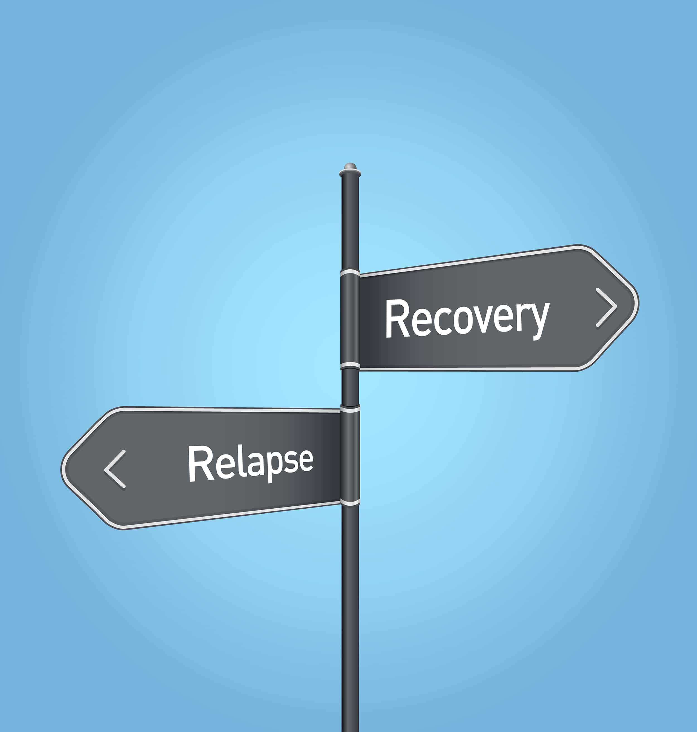
What is a relapse?
A relapse is when you backtrack to old behaviors, attitudes, and habits after a time of improvement. It is commonly associated with drug abuse but can apply to other behaviors such as eating junk food, not taking medication, and drinking too much.

Slide 3
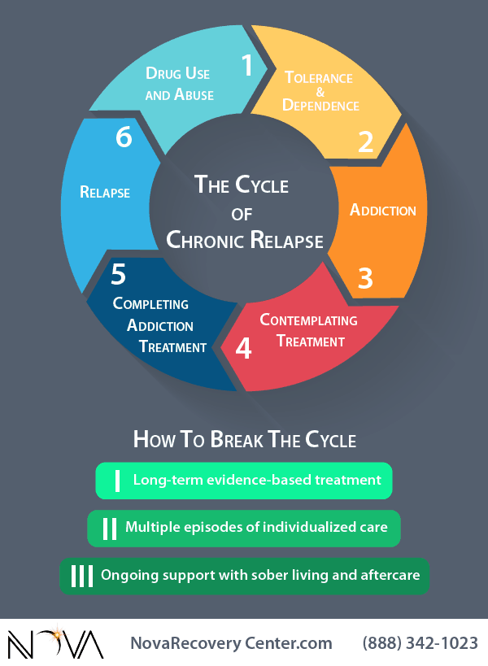
Why is It unhealthy?
Relapsing is unhealthy because it can be a sign of being stuck in a loop of temporary fixes leading to the same old patterns. This is called chronic relapse. Where you continue to go in a circle of drug use, dependance, addiction, thinking of treatment, completing treatment, relapse and coming back to drug use and abuse.

Slide 4
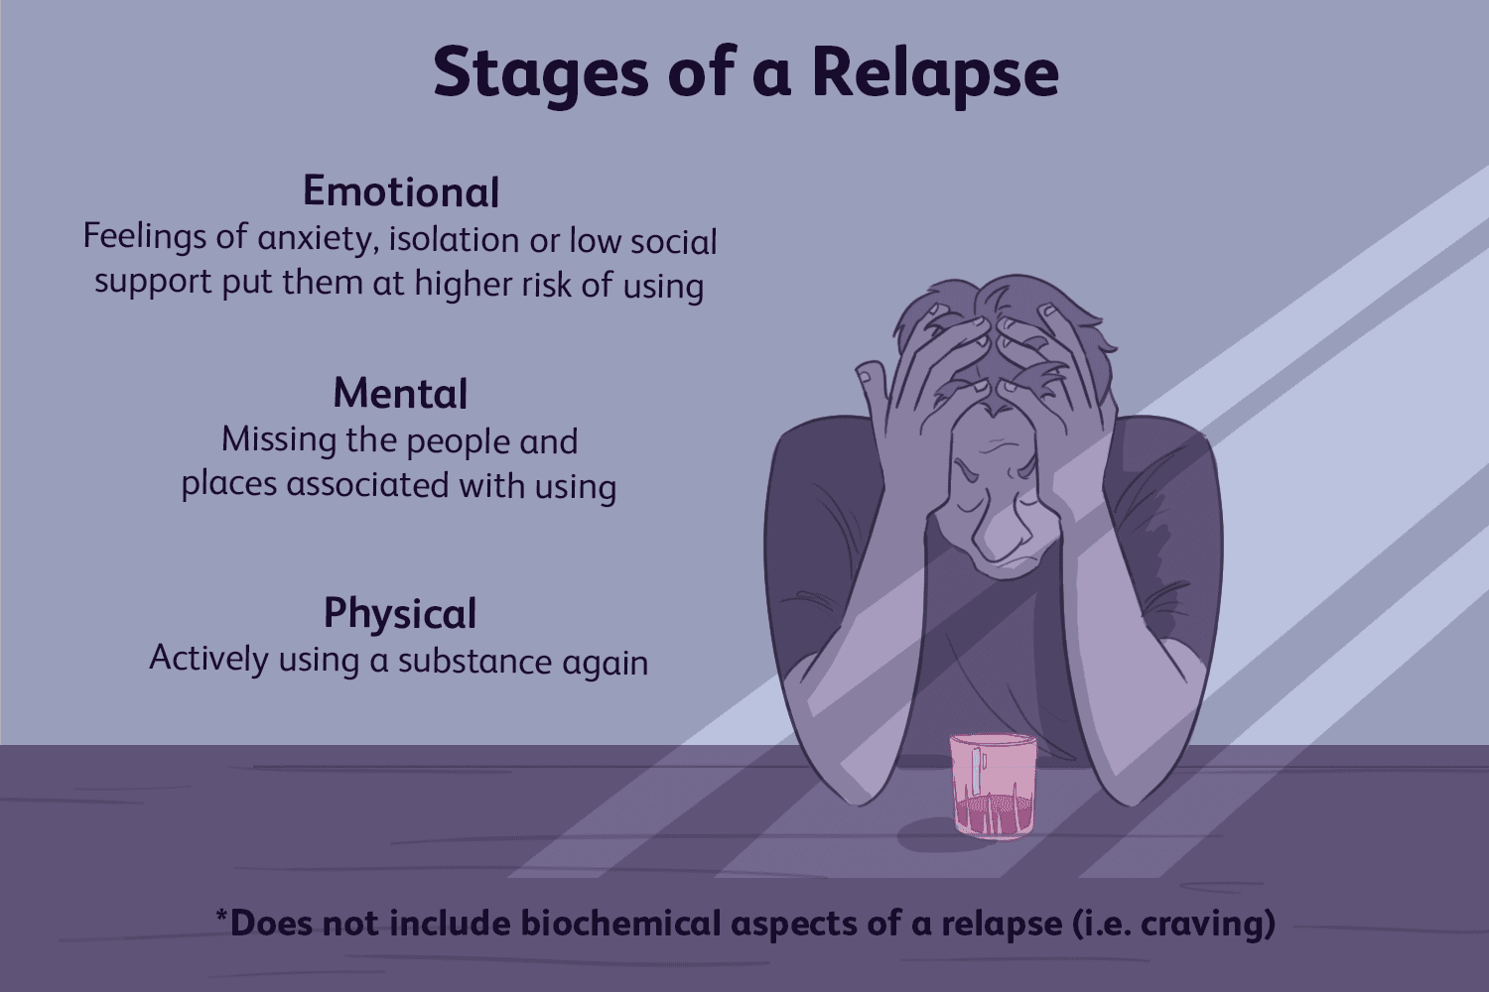
Reasons for relapse
There are four major reasons for relapse. These can be associated with all the types of relapse but usually more than one play a major role. Emotional, Mental, Physical, and Biochemical (craving).

Slide 5

Take accountability
Accept that you relapsed and have lost some progress. You made an error in judgement, a wrong decision, fell back on bad habits, or chose not to take your medication, or give into cravings. Accept this as a fact, do not deny it out of shame but accept it out of strength. Let out your emotions if you need, cry, be angry at yourself, etc. But….

Slide 6
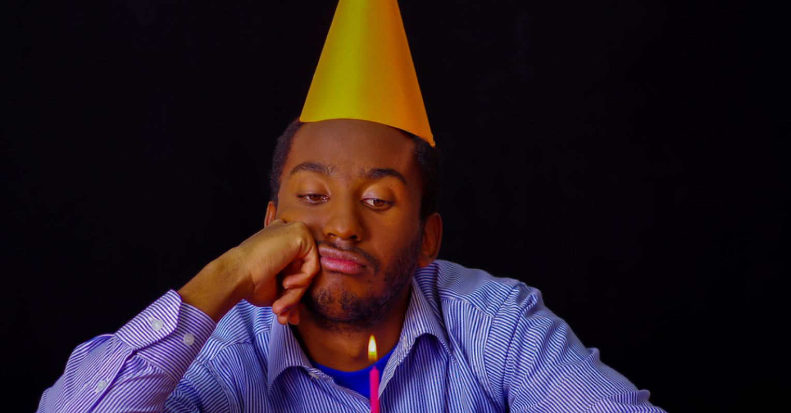
No pity parties.
A pity party is a state of mind where you focus on the negatives of your behavior after a prolonged period of study. Once you have drawn the benefit from the negative it is important to pick yourself up and move on. Yes, you relapsed. Now you’ve learned from it. Don’t become stuck being sad about it.

Slide 7
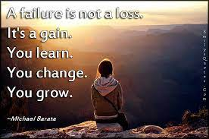
Identify why you relapsed. What triggered you?
Look deep into your triggers and figure out why you relapsed and what you could have done different for the next time. If you learned from the relapse then it isn’t a loss, it is a lesson. The journey is about learning and developing over time. Use the knowledge gained from a relapse for better behavior next time.

Slide 8
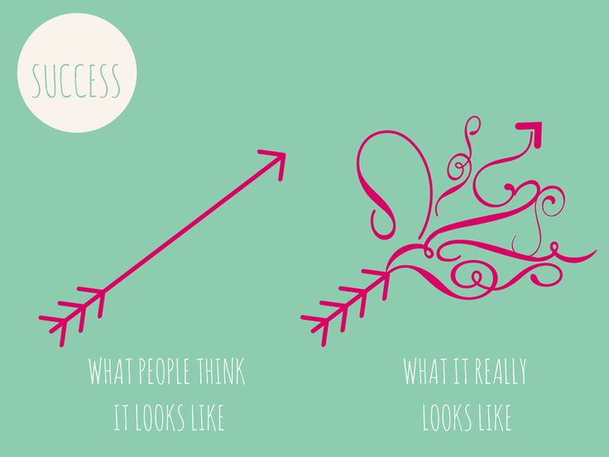
Progressive Relapse
Progressive relapse is a different way to view a relapse. It accepts that during a healing journey there will be ups, downs, and loops. It is very rare for someone to quit destructive behaviors the very first time. A progressive relapse is a type of relapse that results in notable progress from the last addictive period. IE. (longer period of successful treatment, shorter time spent in the hospital, different reason for relapse, a new realization about addiction/poor behavior.

Slide 9
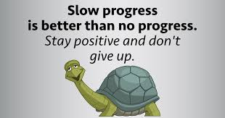
Slow progress is better than no progress.
The concept of progressive relapse relies on the belief that slow progress is better than no progress. It is better to make small permanent steps towards growth than large temporary steps. Growth also comes in stages and over time. A relapse can be a natural part of the process. Make sure you identify and analyze properly.

Slide 10

The ENd
“Progress is like climbing a mountain. Sometimes you fall, scrape your knee, and get out of breath. But don’t stop climbing!”

