Slide 1

Overcoming Stigma – Support Groups
Family, Friends, etc.

Slide 2

No Human is an island
Being alone can be good for self improvement and growth. But having a support group who is there to cheerlead you on will make things much easier.

Slide 3

Two Types of Support Groups - Institutional
Institutional
Institutional supports groups are support groups designed by a third party group to serve you on your healing journey. (Hospitals, Across Boundaries, CMHA, Doctors, Health Centers.)

Slide 4
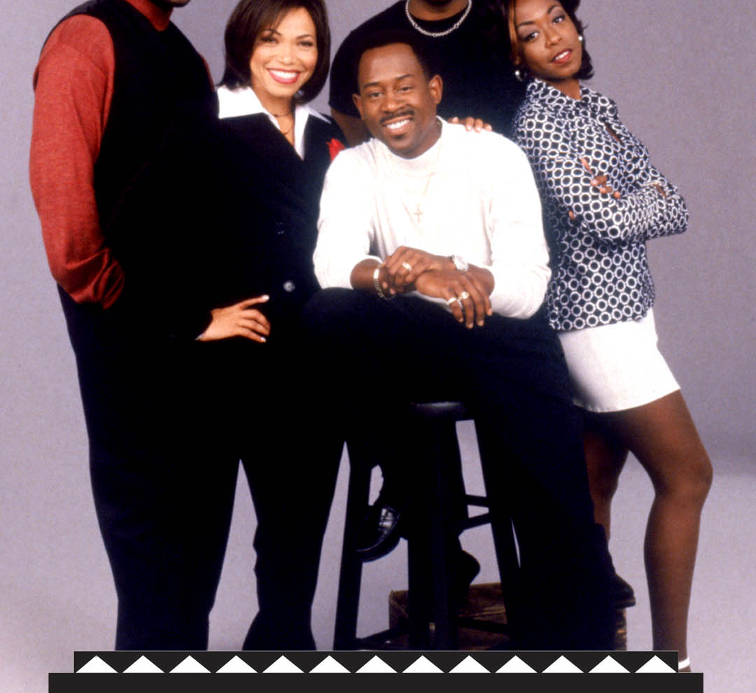
Non-Institutional
Non-Institutional support groups are support groups that you manage yourself. They are also focused on your healing journey but they are more intimate yet more difficult to maintain.

Slide 5
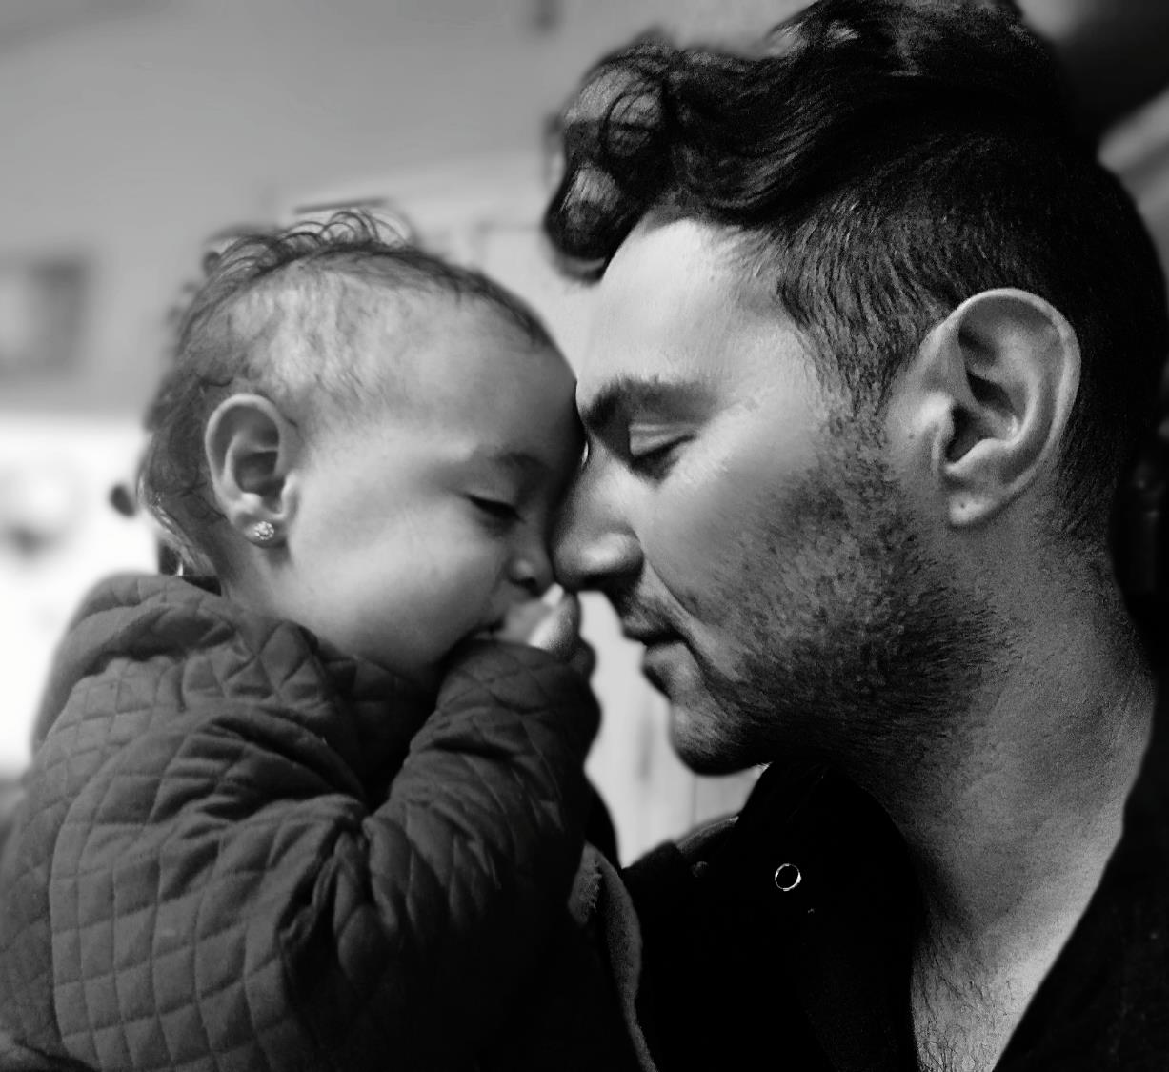
Family
Family are a special type of non-institutional support group because we are all born into a family. Culture plays a big role on how stigma and trauma is handling during our mental health journey.

Slide 6

Companions
Pets can be a great way to find companionship and care. Taking care of another life will help you build healthy habits and strict routines. This can help on your personal healing journey and build responsibility and trust in yourself. You got this!

Slide 7

Dating
Dating is not easy. It never was and never will be. Having a mental health issue does make it harder, but it is FAR from impossible.
A healthy relationship can sometimes be the extra motivation you need to get out of bed and get things done. But it can also be the reason why you don’t want to get out bed at all. Don’t rush the dating journey, trust the process.

Slide 8

Fruits of Labor
Support groups are only as healthy as you make them. You are the deciding factor for how healthy your support group is. Communicate, communicate, communicate! Your voice must be heard and your health nurtured.

Slide 9

THE STAR OF THE SHOW
Dealing with a mental health issue is a full time position. You will stumble sometimes, but you are strong enough to keep walking. You have to be the star of the show. If you don’t make yourself your number one priority then who will?
Do not spiral into a pit of sadness because you do not place enough value on yourself.

Slide 10
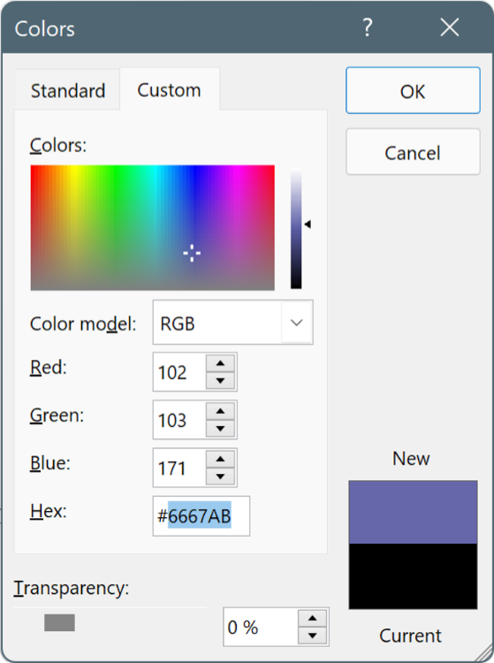
Color Exercise – Green means healthy, yellow means could be better, red means needs improvement.
Draw a large pie chart (a circle graph)
In the pie chart break down how much friends, family, partner, companions, institutional support groups are involved in your life.
Give each support group a color that represents healthy impact.
Draw another large pie chart (a circle graph)
In the pie chart break down how much you WANT them to be involved.
Give each support group a color that represents healthy impact.

Slide 11
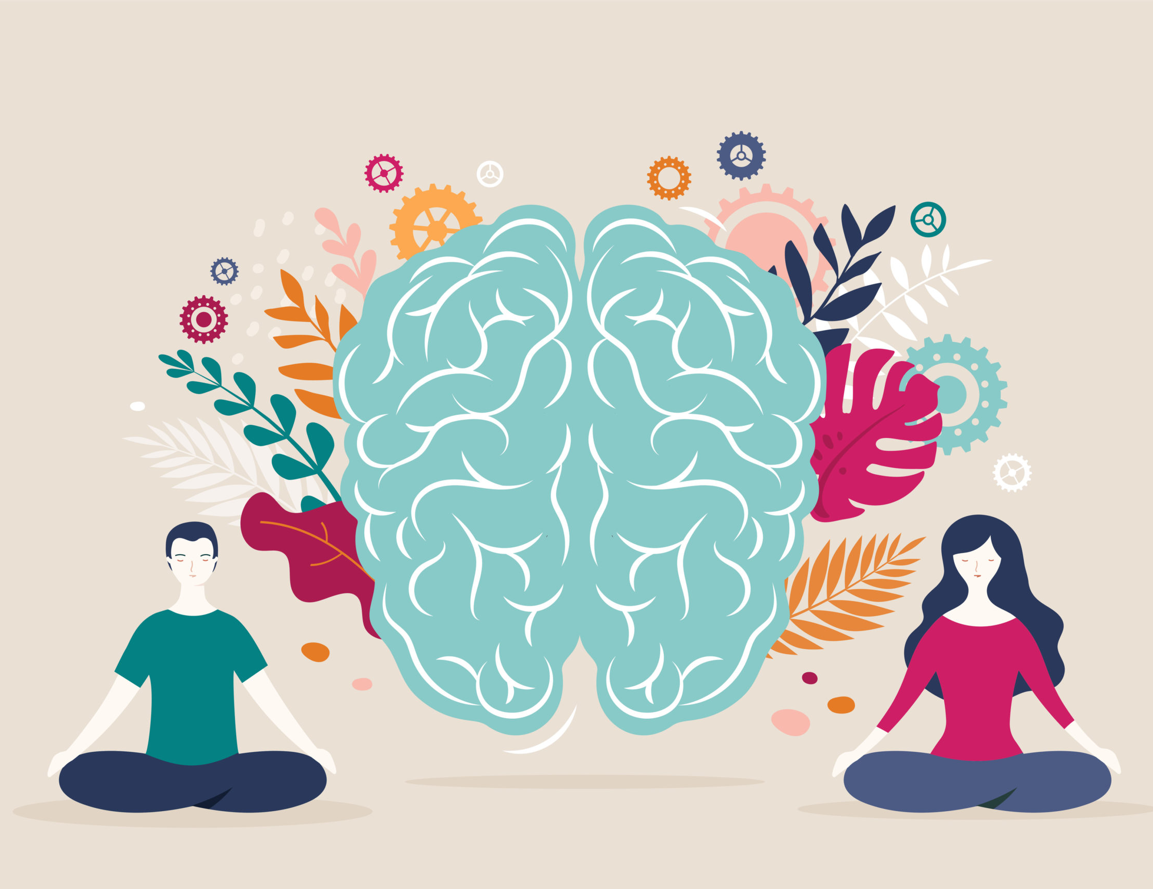
Next Topic
Mental Overload and Coping Tactics.

